Slide 1
Intake of food, water, Air, Sunlight, Work and Ergonomics
IKS/Unit-3

Slide 2
The five elements—food, water, air, sunlight, and ergonomics—as the foundational pillars of human health and productivity.
These factors are interconnected. For example, poor ergonomics can limit outdoor activity (sunlight), and dehydration (water) can cause fatigue, impacting concentration at work.
Practical tips for integrating these essential inputs into daily life to boost energy and prevent injury.

Slide 3


Slide 4
Food intake
The fuel for life: food provides the energy (measured in calories) and nutrients the body needs to build, maintain, and repair tissues.
Balanced nutrition: balanced diet is required with macronutrients (carbohydrates, proteins, fats) and micronutrients (vitamins, minerals).
Healthy eating tips:
  Eat smaller, more frequent meals to maintain energy levels.
  Prioritize fruits, vegetables, and whole grains.
  Reduce intake of saturated fats, sugar, and salt.
  Avoid skipping breakfast.

Slide 5
Mental and Cognitive Effects: There is growing evidence that nutrition has a significant impact on mental health. Healthy nutrition, for instance, has been associated with improved mental health symptoms, while malnutrition is related to a lowered ability to cope with stress, poor concentration, and mood swings.
Study Diet and Cognitive Function: In a study conducted on children and adolescents in Korea, researchers found that the intake of fast food and sweetened beverages was inversely related to cognitive test scores, while healthy foods, such as nuts, were positively associated.

Slide 6
Water intake
The body's primary component: State that the human body is mostly water, and every bodily system depends on it to function.
Key functions of water: Use icons to illustrate water's roles in:
  Regulating body temperature
  Lubricating joints and eyes
  Helping with digestion and flushing out waste
Signs of dehydration: Explain how to recognize dehydration symptoms like unclear thinking, mood changes, and overheating.
Staying hydrated:
Encourage carrying a reusable water bottle.
Some water comes from food like soups and fruits.
Setting reminders to drink water.

Slide 7
The first known initiative to ring a bell for water breaks in schools was started in India. The Indian state of Kerala is widely credited with pioneering the "water bell" system in 2019 to help students stay hydrated.
The initiative has since gained traction and spread to other Indian states:
Karnataka
Telangana
Odisha
Andhra Pradesh
Tamil Nadu
The concept of the "water bell" has been widely praised by health experts and educators for its effectiveness in promoting student well-being and concentration in the classroom

Slide 8
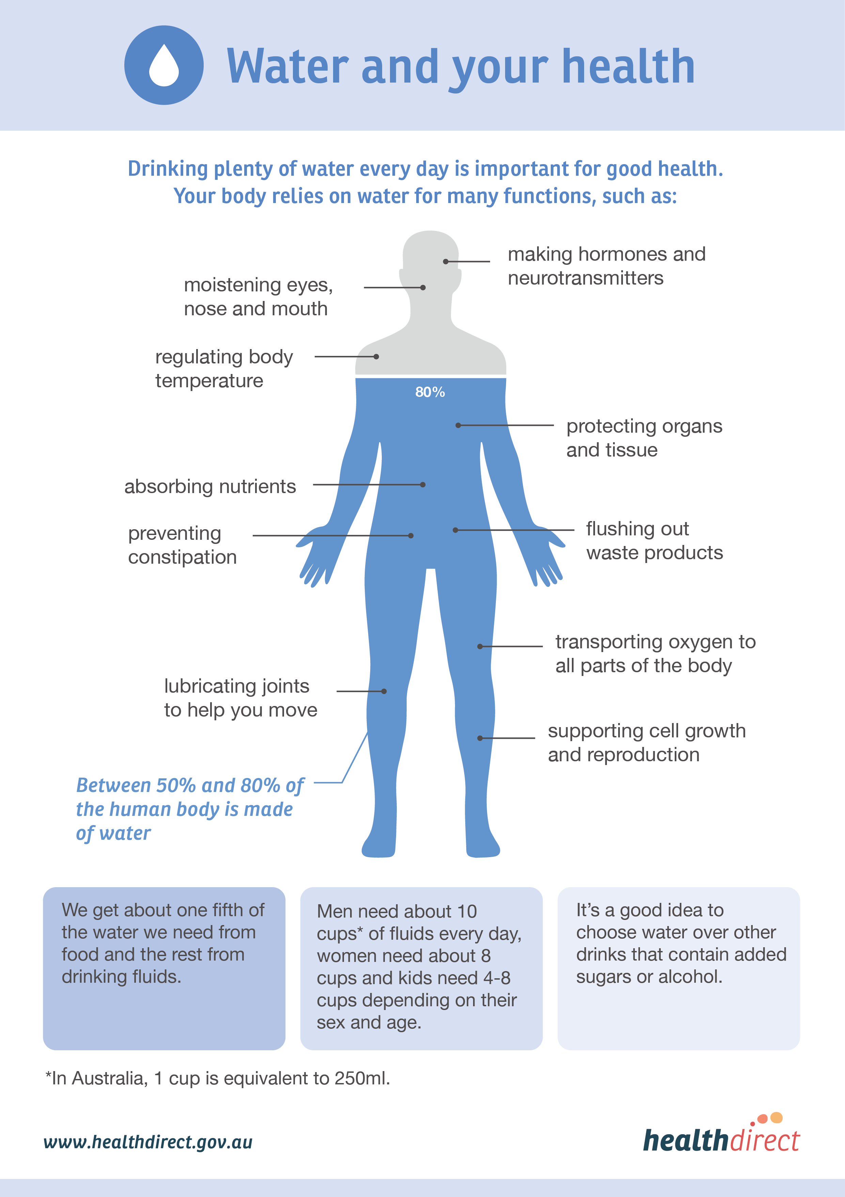
Source: healthdirect

Slide 9
Impact of dehydration: Even mild dehydration (losing 1–2% of body water) can cause reduced attention, memory, and mood, as well as increased fatigue. A 2025 study found that habitually low fluid intake leads to a sharper increase in the stress hormone cortisol during stressful situations.

Slide 10
Air
The engine's breath: As an engine's intake air to system to similarly the human body needs clean air for efficient "combustion" or energy production.
Importance of fresh air: spending time outdoors and ensuring good ventilation in indoor spaces.
Poor air quality effects: effects of air pollutants, which can be linked to fatigue and other health issues.
Tips for better air:Go for regular walks in green spaces.
Keep windows open when possible.
Use air purifiers to improve indoor air quality.

Slide 11
Air pollution and cognitive decline: Epidemiological studies have found that long-term exposure to air pollutants, like fine particulate matter (PM2.5) and nitrogen dioxide (NO2), is associated with accelerated cognitive decline and an increased risk of neurological disorders, including dementia.

Slide 12
Sunlight
The natural vitamin boost: Highlight sunlight's most well-known benefit: boosting the body's vitamin D supply.
The light and dark of it: Present a balanced view, mentioning both the health benefits and risks of sun exposure.
  Benefits: Better bone health, improved mood, and better sleep.
  Risks: Overexposure to UV rays can increase the risk of skin cancer.
  Sun safety recommendations:
  Use sunscreen and wear protective clothing.
  Avoid the sun during peak UV hours.
  Explain that a small amount of unprotected exposure can be sufficient for vitamin D synthesis.

Slide 13
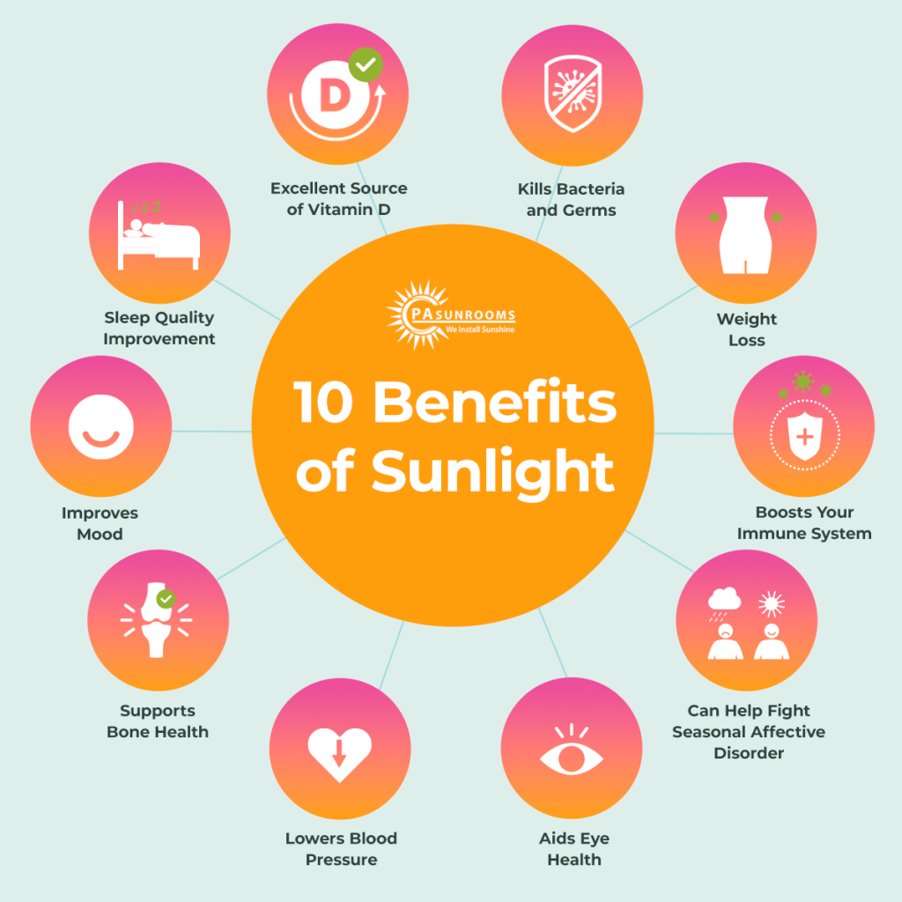
Source: https://pasunrooms.com/blog/sunshine-benefits/

Slide 14
Natural light exposure during the day helps regulate sleep-wake cycles and boosts mood by increasing serotonin, a neurotransmitter associated with feelings of happiness. Poor sleep can cause mood disturbances and impact overall health.
  Workspace: Arrange frequently used items within easy reach.
Ergonomic movement and breaks:
  Take frequent breaks to stretch and move.
  Adjust your posture regularly to avoid static positions.

Slide 15
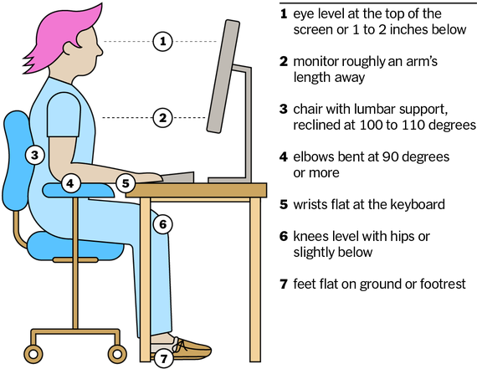
Source: Biofunctionalhealth

Slide 16
Work and ergonomics
Fit the job to the worker: Ergonomics is the science of designing the workplace to fit the worker, not the other way around.
Benefits of good ergonomics:
  Reduces discomfort and risk of injury.
  Maximizes productivity and efficiency.
  Prevents musculoskeletal disorders (WMSDs).
Ergonomic workstation setup:
  Monitor: Place at or slightly below eye level.
  Chair: Use an adjustable chair that supports your back.
  Keyboard and mouse: Keep wrists in a straight, neutral position.

Slide 17
References
McLean Hospital. (2025, July 28). Fueling the mind: The powerful link between nutrition and mental health. https://www.mcleanhospital.org/essential/nutrition
Yoo, J., et al. (2017). Relationships between Dietary Intake and Cognitive Function in Healthy Korean Children and Adolescents. National Institutes of Health (NIH). https://pmc.ncbi.nlm.nih.gov/articles/PMC5332116/
National Eating Disorders Collaboration. (n.d.). The starved brain. https://nedc.com.au/eating-disorder-resources/find-resources/show/issue-59-i-the-starved-brain-can-what-we-eat-determine-how-we-think
Better Health Channel. (n.d.). Water – a vital nutrient. https://www.betterhealth.vic.gov.au/health/healthyliving/water-a-vital-nutrient
Harvard Health Publishing. (n.d.). How much water should I drink a day? https://www.health.harvard.edu/staying-healthy/how-much-water-should-you-drink

